Slide 1



Strat. Consultancy Project I & Data Analytics
MT5125 | MSc in Business Administration | 2020/2021
Dr. Damien Dupré
damien.dupre@dcu.ie
Assistant Professor - Business Research Methods

Slide 2
1. Data Storage and Access

Slide 3
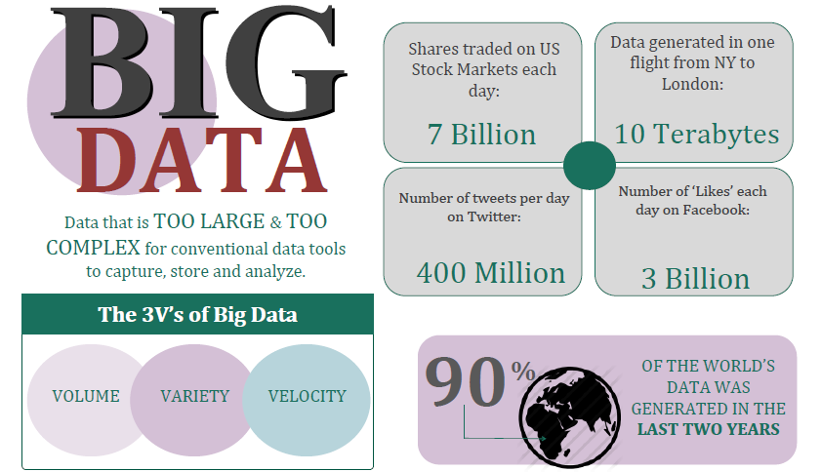
Big Data Everywhere!

Slide 4
What is Big Data
Too large or too complex to be handled by conventional tools
Microsoft Excel’s Limits (current version)
Total number of rows: 1,048,576 rows
Total number columns: 16,384 columns

Slide 5
Data vs. Information (1)
Without data an organization could not successfully complete most business activities
Data consists of raw facts
Information is one of an organisation’s most valuable resources
Often confused with the term data
To transform data into useful information

Slide 6
Data vs. Information (2)
Example: Sales Manager
Knowing number of sales for each representative
(fact – data)
Knowing total monthly sales
(transformed – information)

Slide 7
Data vs. Information (3)
Data
Transformation process
(selecting, organizing and manipulating data)
Information

Slide 8
Value of Information
Goals
Helps decision makers achieve organisational goals
Performance
Valuable information helps people and organisations perform
Accuracy
Inaccurate/Incomplete information leads to Poor Decisions and can result in High Cost for the organisation

Slide 9
Data Analytics
The science of using data to build models that lead to better decisions that in turn add value to individuals, companies and institutions
The analysis of data, typically large sets of data, by the use of mathematics, statistics, and computer software

Slide 10
Data Analytics Tasks
VISUALISE
IMPORT
TRANSFORM
COMMUNICATE
MODEL

Slide 11







Data Analytics Tools
SQL
TRANSFORM
EXCEL
VISUALISE & MODEL
IMPORT
TABLEAU
JAMOVI
COMMUNICATE
WORD

Slide 12
Data Storage

Slide 13
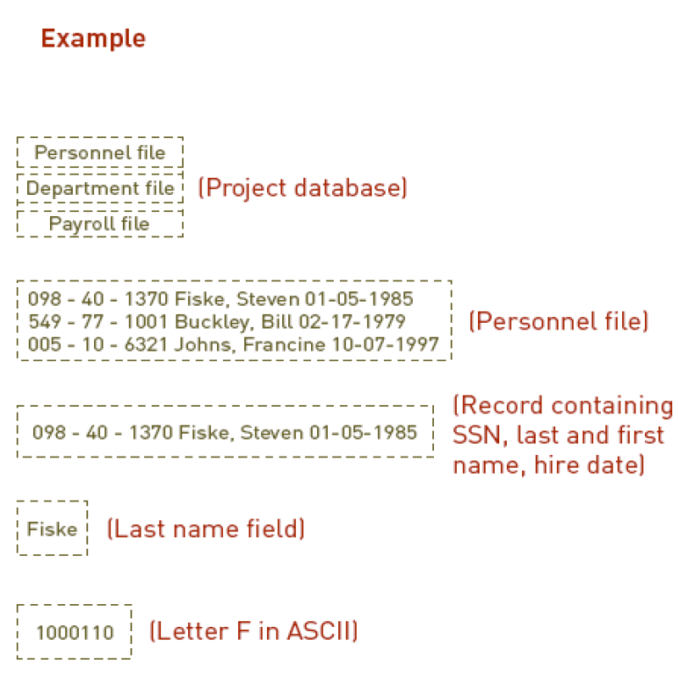
The Hierarchy of Data
Levels
Database
1
A database contains one or more Tables/Files
Tables/Files
2
A Table/File contains a number of records/observations
3
Records/Observations
A record/observation
contains a number of fields/variable
4
Fields/Variables
5
Characters (bytes)

Slide 14
Database Access
Database
When building a database, organizations must consider:
Content: What data should be collected and at what cost?
Access: What data should be provided to which users and when?
Logical structure: How should data be arranged so that it makes sense to a given user?
Levels
1
Tables/Files
2
3
Records/Observations
4
Fields/Variables
5
Characters (bytes)

Slide 15


Access to Databases
Allows dozens or hundreds of people to access the same database system at the same time:
Hosted on a remote “cloud” server (usually)
Database client manager
Host address (IP or URL)
Guest Access
TCP Port (e.g. 5432)
Login/password
Gateway for another tool

Slide 16
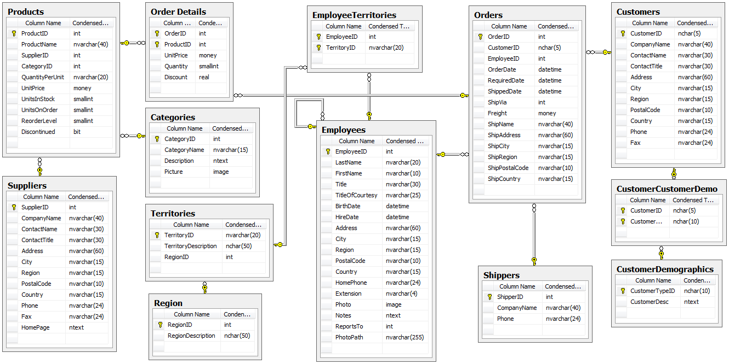
Relational Database
Northwind PostgreSQL Database

Slide 17
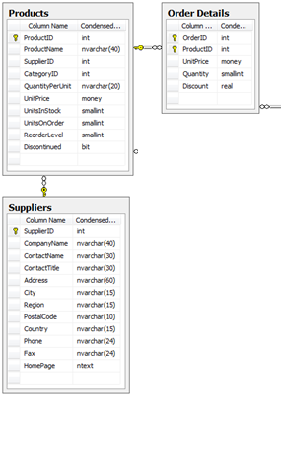
The Relational Principle
Every product gets ONE record in the Products table
Every supplier gets ONE record in the Suppliers table
Rows in different tables can be related to another using a shared key
There can be multiple product records for a given supplier

Slide 18
The Relational Principle
Related records can be found using a shared key
Shared key = identifier that is:
Unique to each table
Can be referenced by another table
E.g.,
Products.ProductID = Order Details.ProductID

Slide 19
Database Schema
The schema describes all tables/files and all fields/variables
Describes relationship between tables
Crucial in enabling retrieval of desired data
Very important
Must understand schema for accurate querying
Wrong understanding = wrong results

Slide 20
Database Queries
Database can be made of millions/billions data spread on hundreds of tables/files
A Query is a set of instructions to retrieve, sort and format returning data
E.g., “find me all customers in my database”
Query = extracting information out of the database and process them into something (e.g., MS Excel)

Slide 21
Query with SQL
Structured Query Language
Way to obtain ONE file with the information you need ONLY
This is the main SQL statement you need to understand for querying:
Translation: “Show me the data from all the fields from the table ‘table_name’”
SELECT *
FROM table_name;

Slide 22
Basic Syntax of SQL SELECT
Show me the data from the fields ‘field_name_1’ and ‘field_name_2’ from the table ‘table_name’
Example:
SELECT field_name_1, field_name_2
FROM table_name;
SELECT ProductID, ProductName
FROM Products;

Slide 23
Basic Syntax of SQL SELECT
Show me the data from the fields ‘field_name_1’ and ‘field_name_2’ from the table ‘table_name’ corresponding to ‘X’ in the field ‘field_name_1’
Example:
SELECT field_name_1, field_name_2
FROM table_name
WHERE field_name_1 = ‘X’;
SELECT ProductID, ProductName
FROM Products
WHERE ProductName = ‘macbook’;

Slide 24
More Possibilities with SELECT
More: https://beginner-sql-tutorial.com/sql-commands.htm
SELECT [DISTINCT|COUNT] field_names
FROM table_name_1
[WHERE conditions]
[GROUP BY field_name]
[ORDER BY field_name]
[LEFT|RIGHT|INNER JOIN table_name_2]
[ON table_name_1.field_name = table_name_2.field_name];

Slide 25
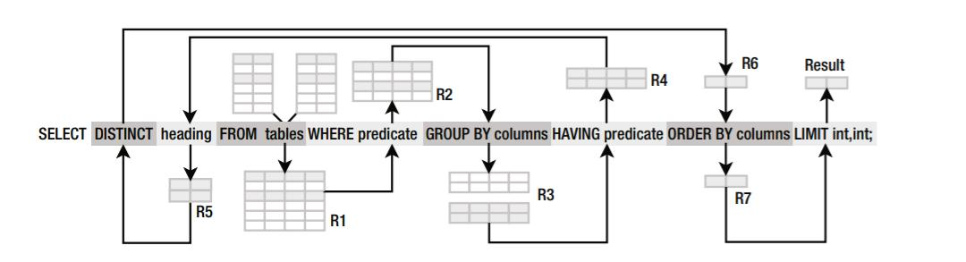
More Possibilities with SELECT
Read/Write Order
Processing Order

Slide 26
Words of Caution
Easy to build queries that
Retrieve nonsense
Never complete, end up completely bogging down the database
Understanding Schema is a way to prevent that

Slide 27
Exercise: Practice SQL

Slide 28
Practice SQL
On the loop page of the module, download the document called “northwind_onlinedemo.txt” on your desktop.
Open your web browser and go to https://sqliteonline.com/ (free emulation of SQL servers).
Click right (Win)/double (Mac) on demo, use DROP

Slide 29
Practice SQL
Copy-Paste the text of the file “northwind_onlinedemo.txt” (3556 lines) and press Run on the top menu bar (you should see the 15 table appears on the left box).
Select all the lines in the box (CTRL + A or Cmd + A) and delete them.
All the game of this tutorial will be to create new tables that can be downloaded for our analyses.

Slide 30
Practice SQL
Run the following commands:
SELECT *
FROM customers
SELECT ProductName, UnitsInStock * UnitPrice AS profit_max
FROM products
SELECT *
FROM customers
WHERE Country = "Mexico"
SELECT COUNT (ContactName), Country
FROM customers
GROUP BY Country
SELECT *
FROM orders
INNER JOIN customers ON orders.CustomerID = customers.CustomerID

Slide 31
Manage Tables/Files

Slide 32
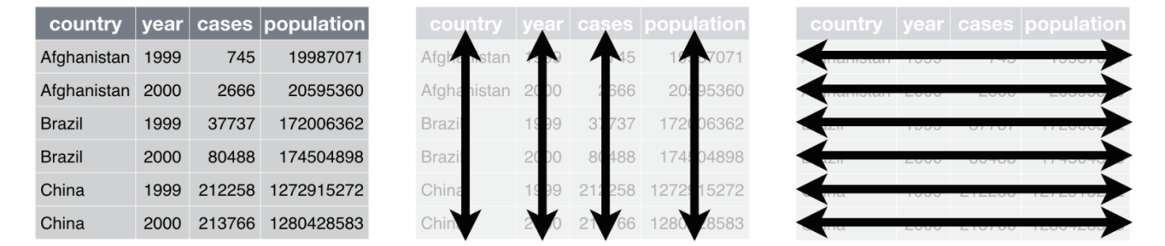
Tables/Files Access
Database
Each variable has its own column
Each observation is placed in its own row
Each value is placed in its own cell
Levels
1
Tables/Files
2
3
Records/Observations
4
Fields/Variables
5
Characters (bytes)

Slide 33

File/Table Structure (1)
Each variable has its own column
Each observation is placed in its own row
Each value is placed in its own cell
Table/File Field/Variable Record/Observation

Slide 34
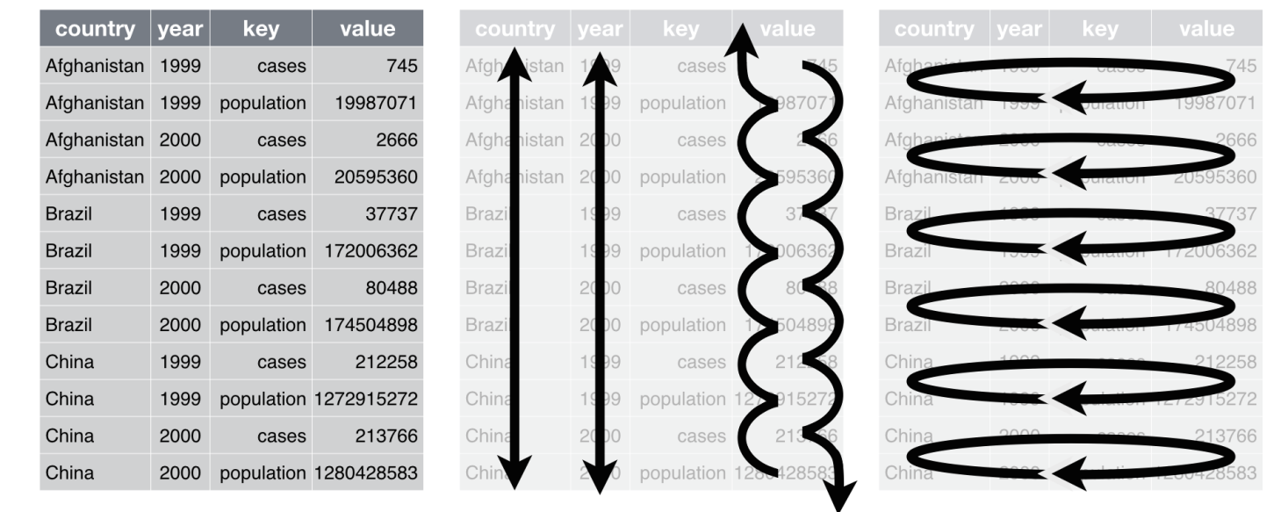
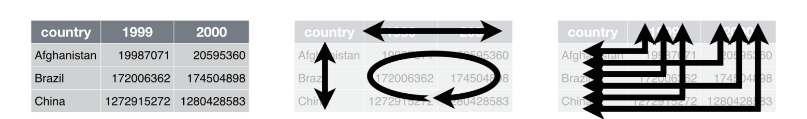
File/Table Structure (2)
Long format
Wide format

Slide 35
Fields/Variables
“Field” when the observation is recorded
“Variable” when all the observations are agglomerated
When processing Files, we are using variables

Slide 36
What is a Variable?
Series of observations/records with different values
if the same value is used this is not a variable
Have different types:
Character
Numeric
Date
...

Slide 37
Naming Conventions
for files and variables
no white space “ “!
Choose either
Camel Case
E.g. someVar, someClass, somePackage.xyz
Pascal Case
E.g. SomeVar, SomeClass, SomePackage.xyz
Snake Case
E.g. some_var, some_class, some_package.xyz

Slide 38
Files Types/Formats
File Extension | Comment
.doc/.docx/.pdf/.jpg/.mp3/.avi/... | Data can be access but needs file processing or OCR
.xls/.xlsx | MS Excel format (not open) which contains interface, metadata and figures. To avoid
.ods/.ots | Open Office spreadsheet format, contains interface, metadata and figures but is open
.csv | Comma Separated Value is the most common data format. Open and light
.txt | Similar to CSV, can be tab separated
.json | JavaScript Object Notation (https://www.json.org/), semi-structured data file
.sav | SPSS format (not open) which contains interface, metadata and figures. To avoid

Slide 39
Convert Data to Information
Extract relevant data from the database with a query
Check that the structure of the obtained file is compatible with your analysis
Process these data with mathematic/statistic calculations

Slide 40
Convert Data to Information
Receiving data extracted from a database is an optimal way to preform analyses
However, it is usual to access data that are gathered and analysed in an Excel file
Local only
No update possible
Messy and unstructured

Slide 41
Convert Data to Information
Next Lecture we will see how to clean and prepare data for our analyses

Slide 42
Homework for Next Lecture
Next time: Data Cleaning and Transformations with Excel
Mandatory
https://www.udemy.com/course/excel_quickstart/
Optional but suggested
https://www.udemy.com/course/ten-excel-features-every-analyst-should-know/
Just have a look for your interest
https://www.udemy.com/course/excel-dashboards-in-an-hour/

Slide 43

Questions?

